Slide 1
Conquering Fashion MNIST with CNNs using Computer Vision

Slide 2
TEAM DETAILS
Team Name: Run The Code
Institution Code(AISHE): 1-3516157399
Institution Name: Rajalakshmi Institute of Technology
Team Members: Balaji S
Aafiya Farheen.E
Team Mentors: Mr.Franklin Telfer
Dr.Pandithurai
Dr.Sathish Kumar

Slide 3
ABSTRACT
This study focuses on conquering the Fashion MNIST dataset using Convolutional Neural Networks (CNNs) and computer vision techniques.
Fashion MNIST consists of grayscale images of fashion items categorized into ten classes, making it a challenging and diverse image classification task.
The proposed approach involves designing a deep CNN architecture with convolutional and pooling layers, followed by fully connected layers.
Techniques like data augmentation and regularization are applied to enhance generalization and prevent overfitting.
The CNN's ability to learn hierarchical features and adapt to complex image patterns contributes significantly to its success in fashion item classification.
The findings highlight the effectiveness of CNNs and computer vision techniques in fashion-related image classification tasks, offering practical solutions for real-world applications in the fashion industry.

Slide 4
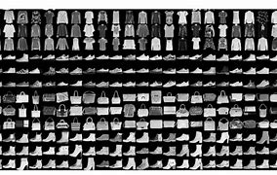
Introduction
👗In this study, we tackle Fashion MNIST using CNNs and Computer Vision techniques. Image classification in fashion is essential for e-commerce and retail. We employ powerful CNNs to automatically extract features from images.
💡 Our goal: push the limits of fashion image classification, optimize CNN architectures, and use data augmentation and transfer learning to enhance accuracy.
🔍 Through meticulous experiments, we explore CNN strengths and limitations for fashion tasks, offering insights for computer vision applications in the fashion industry.

Slide 5
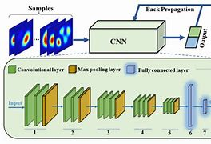
What Is Convolution Neural Network

Slide 6
BUILDING THE CNN MODEL
CNN Model Architecture:
Convolutional layer (32 filters, 3x3 kernel, ReLU activation)
MaxPooling layer (2x2 pool size)
Convolutional layer (64 filters, 3x3 kernel, ReLU activation)
MaxPooling layer (2x2 pool size)
Flatten layer
Fully connected layer (128 nodes, ReLU activation)
Output layer (10 nodes, SoftMax activation)

Slide 7
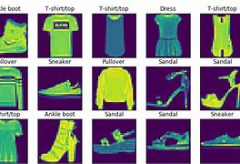
NEED FOR CNN FOR FASHION MNIST
Fashion Image Classification: It highlights the necessity for accurate and efficient image classification in the fashion domain, catering to industries like e-commerce and fashion retail that rely on automated product tagging and inventory management.
Practical Applications: Practical implications for the fashion industry, such as improving product recommendation systems, enhancing customer experience, and enabling accessibility for visually impaired individuals, are highlighted.
AI Revolution in Fashion: It concludes with an inspiring message, inviting readers to join the AI revolution in fashion image classification and explore new horizons in computer vision applications.

Slide 8
USE CASES
Fashion Trend Analysis: Image classification aids in identifying popular fashion trends by analyzing large datasets, helping fashion designers and retailers stay ahead in the ever-changing fashion landscape.
Assistive Technology for Visually Impaired: Fashion image classification with CNNs can be used in assistive technology for visually impaired individuals, helping them Identify clothing items and make informed fashion choices.
Virtual Try-On Solutions: By classifying fashion items accurately, virtual try-on solutions can recommend suitable clothing options to customers, allowing them to visualize how specific items would look on them before making a purchase.

Slide 9
References:
Fashion MNIST dataset: Xiao, H., Rasul, K., & Vollgraf, R. (2017). Fashion-MNIST: a Novel Image Dataset for Benchmarking Machine Learning Algorithms. arXiv preprint arXiv:1708.07747.
"Hands-On Machine Learning with Scikit-Learn, Keras, and TensorFlow" by Aurélien Géron
"Deep Learning for Computer Vision" by Rajalingappaa Shanmugamani
"Practical Convolutional Neural Networks" by Mohit Sewak
"Computer Vision: Algorithms and Applications" by Richard Szeliski

